Slide 1
GMOs – History of Agriculture
Notes:
G

Slide 2
Agriculture Defined
The art, science, and business of managing the growth of plants and animals for human use.
Cultivation of the soil
Growing & harvesting crops
Breeding & raising of livestock
Packing, processing, and marketing
http://www.ars.usda.gov/is/graphics/photos/

Slide 3
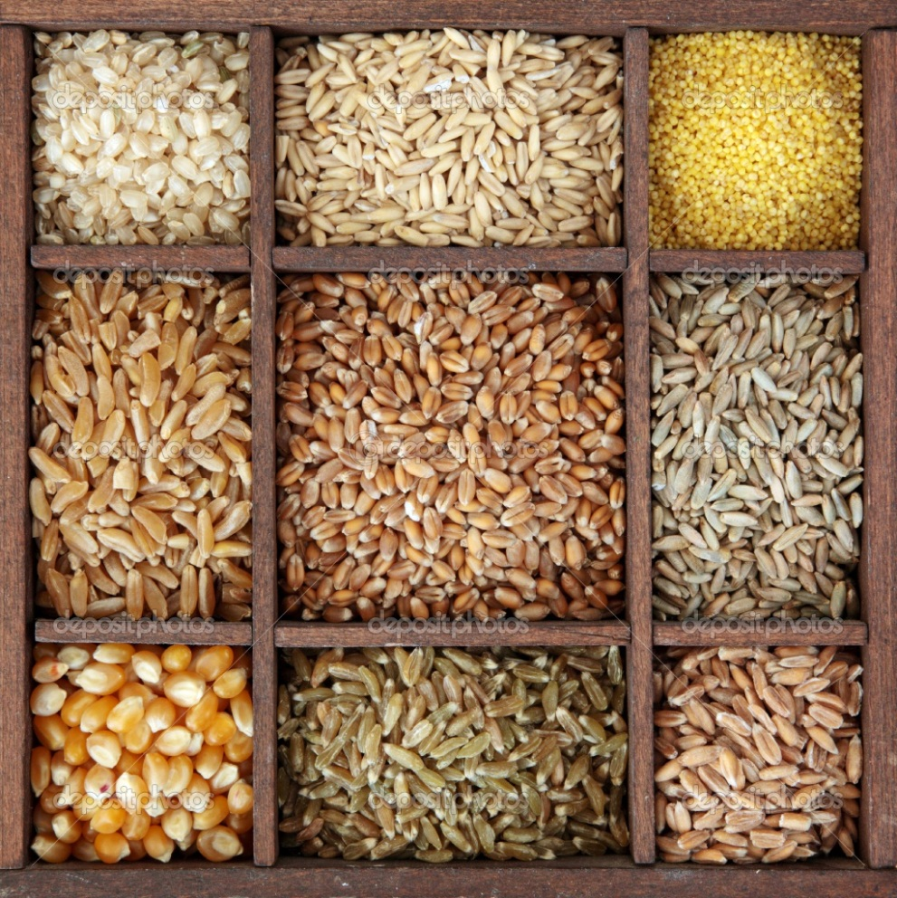
Agriculture Defined
Began over 10,000 years ago
Humans “domesticated”
Cereals (plants with big starchy seeds)
Corn
Rice
Wheat
Barely
Millet
Fruits
Apple
Plum
Meat animals
Cows
Goats
Pigs
Poultry (birds)
Fish

Slide 4
Domestication
Process by which plants or animals are changed at the genetic level through human selection
Debate of intentional vs non-intentional process
Intentional –
Plants – humans understood plant propagation and started collecting and planting seeds in areas that were good to live (near water)
Animals – humans trapped animals and kept them in confined areas so they didn’t have to chase them
Non-intentional –
Plants - human waste piles from eating plants deposited the seeds and these became the first “gardens” or “plots”
Animals – humans changed animal behavior because of the accidental gardens, because suddenly there was more food around and it caused animals to stay around

Slide 5
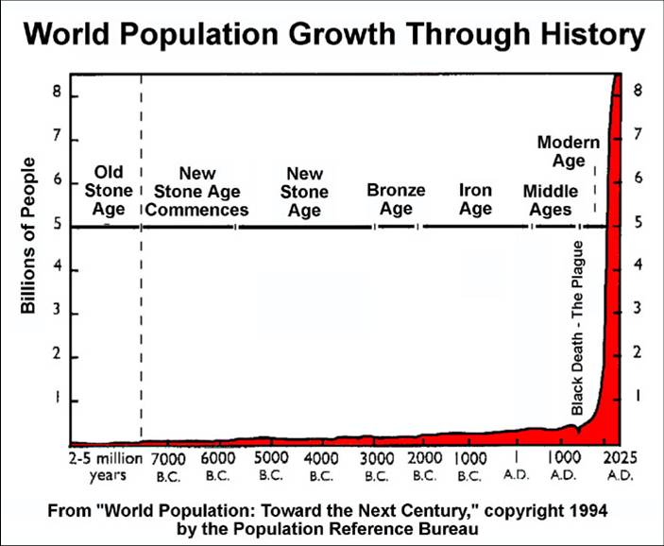
Pre - Domestication
The majority of human time on the planet has been pre-domestication ~3million years!

Slide 6
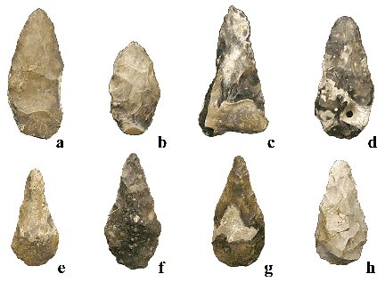
Pre - Domestication
Hunter – Gatherer Period
Paleolithic “Old Stone Age”
Named because of tools we can find from that age
Hunting/gathering behaviors exist back 3 million years to the dawn of man’s cultural evolution.
No word for “work” exists in various languages of hunters/gatherers.
Do hunting/gathering societies still exist today?
Does modern mankind exhibit characteristics of hunter/gatherers??

Slide 7
Transition from Hunting-Gathering to Agriculture
Human population growth rate increased slowly:
A. 0.0007- 0.0020 % /yr. Paleolithic
B. 0.1 % /yr. Neolithic
C. 1-2 % /yr. Present day
Low birth/survival rate attributed to lifestyle of hunter-gatherer – not food scarcity.
Not ignorance of plant growth, but lack of need to practice agriculture prevented earlier development of agriculture.

Slide 8
Transition from Hunting-Gathering to Agriculture
Wild seeds were abundant, inexhaustible, and could easily be harvested
In Turkey, a person could harvest 2.2 lbs. of wild wheat (einkorn, which contains 57% more protein than current domestic wheat) in an hour
In Mexico, an 11-day supply of “wild corn” (teosinte) could be gathered in 3.5 hours
In Wisconsin, Ojibwa Indians could fill their canoes with wild rice in a few hours.

Slide 9
Transition from Hunting-Gathering to Agriculture
Earth’s carrying capacity for hunter-gatherers estimated at 20-30 million. How many people exist on Earth today?
Man simultaneously developed agriculture worldwide 10,000 years ago, after the last Ice Age…suggests that climate changes contributed to the cultivation of plants and animals
What about today…Are resources shrinking? How will this affect society??
Today? Tomorrow?

Slide 10
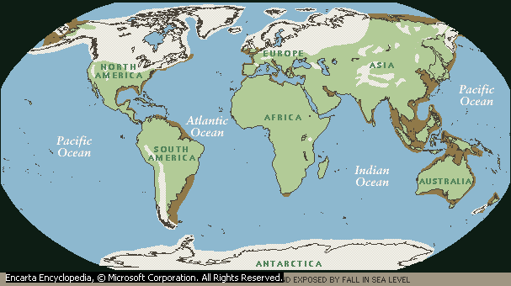
Neolithic Ice-Age 10,000 years ago

Slide 11
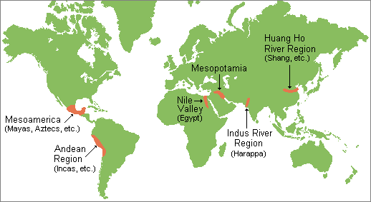
Neolithic Civilizations

Slide 12
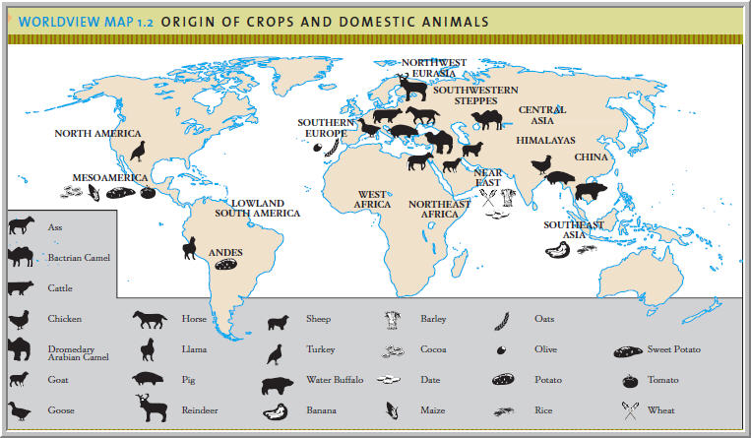
Neolithic Civilizations

Slide 14
Neolithic Settlements
More permanent than camps of hunting populations
Needed to move periodically
Soils deteriorated
Practiced slash & burn in Europe
Nile settlements more permanent
River kept soils fertile

Slide 15
Neolithic Farmers
Lived in caves, sun-baked mud houses, of reed or wooden houses
Housed grouped into small villages with surrounding fields
Growth of cities such as Jericho (9000 BC) was stimulated by production of surplus crops

Slide 16
Pastoralism
A later development
Mixed farming, combining cultivation of crops and stock raising was a common Neolithic pattern
Nomadic herders roamed steppes of Europe and Asia where the horse and camel were domesticated

Slide 17
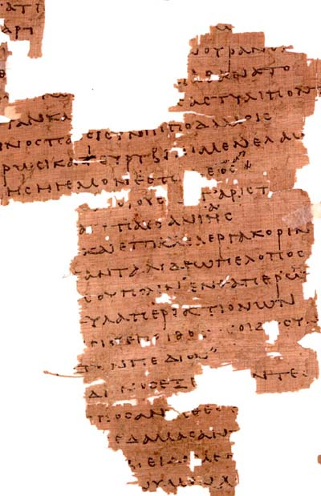
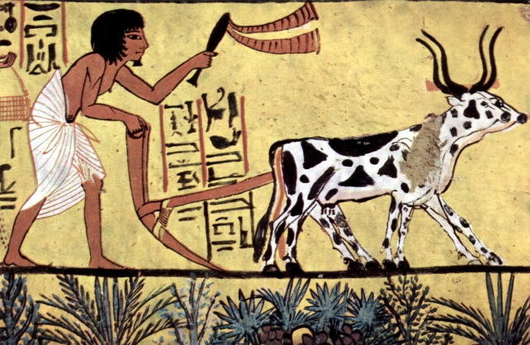
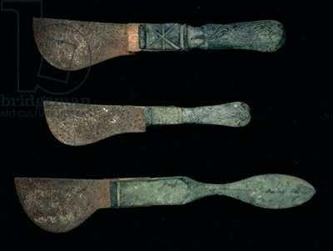
Historical Agriculture Through the Roman Period
Roughly defined as 2500 BC to 500 ad
Introduction of metals
Agriculture application big
Sturdy long lasting tools
Information from:
Bible
Near Eastern record & monuments
Chinese, Greek, & Roman writings
Later dev in Central & S. America

Slide 18
Historical Agriculture Through the Roman Period
Irrigation in China, Egypt, & Near East
Allowed more land to be cultivated
Windmills and water mills added at end of Roman period
Introduction of fertilizers
Animal manures
Crop rotations
http://www.ars.usda.gov/is/graphics/photos/

Slide 19
Feudal Agriculture
500 – 1100 CE (common era)
Irrigation extended in Egypt & Spain
Grain production was sufficient in Egypt to sell wheat internationally
Irrigation from mountain streams increased vineyards in Spain
In Spain silkworm was raised and its food the mulberry tree was grown

Slide 20
Feudal Agriculture
Manorial system
900 to 2000 acres
Self-contained community
Large home for the lord
One or more villages as part of the manor
Peasants were the actual farmers
Raised crops and livestock and paid taxes to the lord
Large mill for grinding grain & vegetable gardens

Slide 21
Feudal Agriculture
Manor system
Woolen garments from sheep
Linen textiles from flax and the oil also
Food served in feudal castle varied according to season & hunting ability
Hunting done by the lord
Castle residents ate meat from poultry, cattle and etc produced by peasant farmers

Slide 22
Scientific Agriculture
Scientific revolution occurred from the Renaissance and Age of Enlightenment in Europe
Plant breeding
Breeding cattle & sheep
Guernsey cow breed
Crop rotations
Drainage brought more land into cultivation

Slide 23
Scientific Agriculture
By 16th century population & agriculture were expanding in Europe
New period of exploration & colonization
Circumvent Turkey’s control of the spice trade
Provide homes for religious refugees
Provide wealth for European nations
http://www.ars.usda.gov/is/graphics/photos/

Slide 24
Scientific Agriculture
Colonial agriculture
Feed colonies
Produce cash crops & feed home country
Cultivation of sugar, cotton, tobacco, tea, animals for wool and hide etc
From 15th to 19th centuries slaves were used
Slaves worked in Caribbean on sugar plantations & in N America

Slide 25
Scientific Agriculture
Livestock breeding in 1700s
Limestone on soils in late 1700s
Cast-iron plow
1797 by Charles Newbold
John Deere improved it in 1830s & made it from steel
Seed drill in early 1700s
Reaper by Cyrus McCormick in 1831

Slide 26
Scientific Agriculture
By late 1800s steam power replaced animal power in drawing plows and operating threshing machinery
Science and technology developed for industrial purposes in agriculture
Resulting in agribusinesses of the mid-20th century
Poisons for pests developed in 19th century
Improvements in transportation (19 & 20th)
http://www.ars.usda.gov/is/graphics/photos/

Slide 27
Scientific Agriculture
After World War II
Green revolution
Selective breeding of crops
DNA technology
Intensive cultivation methods
Machinery development
http://www.ars.usda.gov/is/graphics/photos/

Slide 28
Green Revolution
Thomas Malthus
19th century economist
Believed that because population grows geometrically and food production arithmetically famine was inevitable.
Slowing the growth of population was the only possibility to prevent starvation

Slide 29
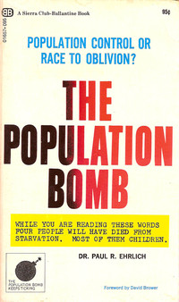
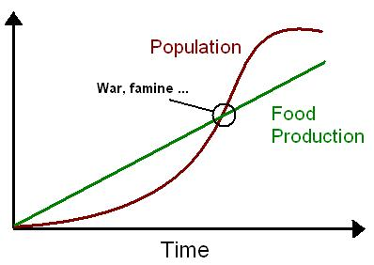
Green Revolution
After World War II
Peace
Birth rates go up
Paul Ralph Ehrlich, 1968

Slide 30
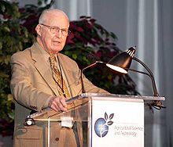
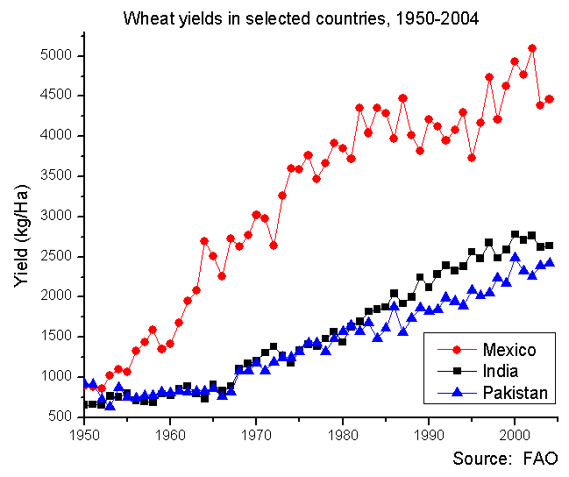
Green Revolution
Norman Borlaug
Intensive plant breeding program
Uses Mexico’s double wheat seasons
Dwarf wheat, so more fits in one area, drought tolerant
Backcrossing to get more resistant strains of plant
Noble Prize in 1970

Slide 31
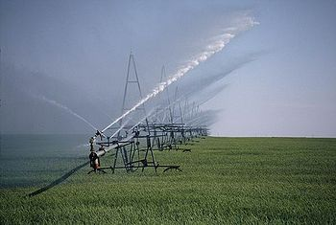
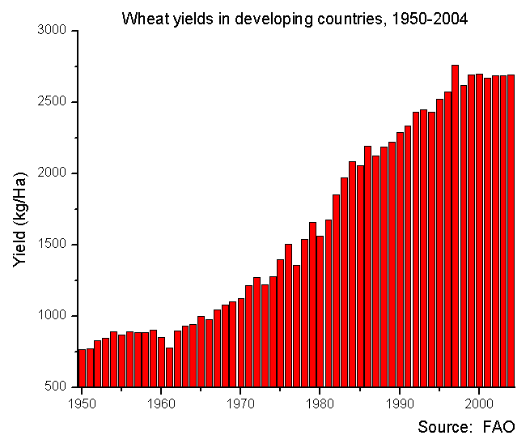
Green Revolution
Synthetic Fertilizer ( made from petroleum)
Use of pesticides
Expansion of highly engineered irrigation / water management systems
Starts with wheat, then rice (Philippines) and other crops
Beginning of GMOs
Developing countries most effected (except Africa)

Slide 32
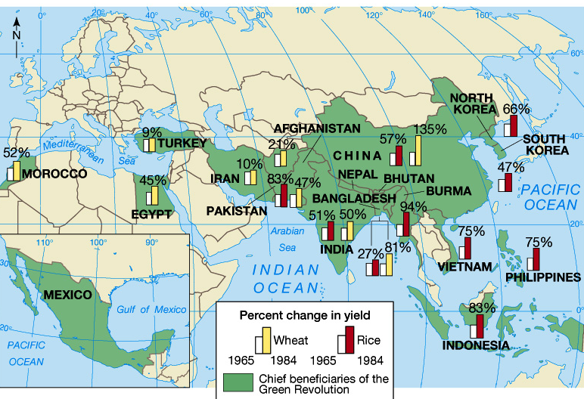
“Green Revolution”

Slide 33
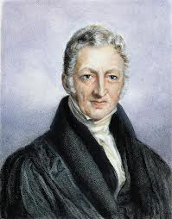
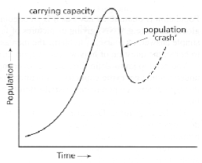
Green Revolution
Have we created just a bigger Malthusain problem?
Because now we are supporting even a larger population than before?
With a finite amount of land.

Slide 34
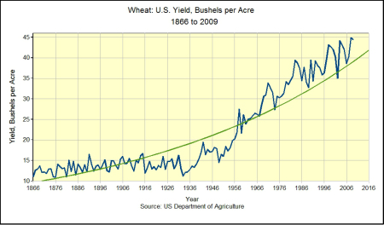
Green Revolution
Green Revolution
First GMO Crops

Slide 35
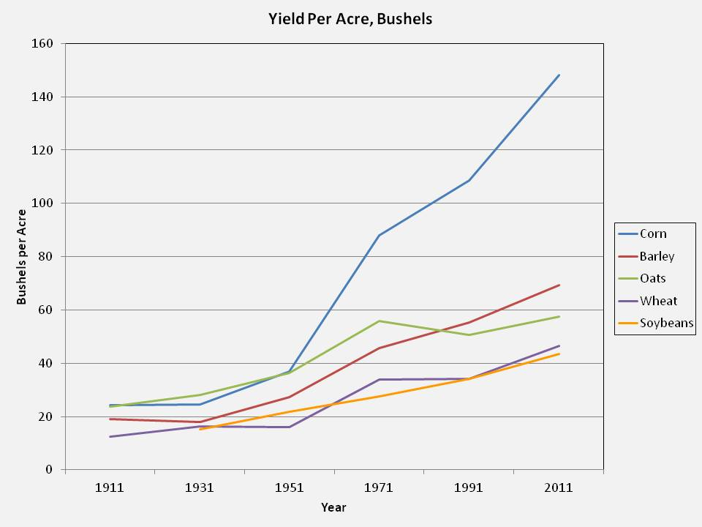
Green Revolution
Green Revolution
First GMO Crops

Slide 36
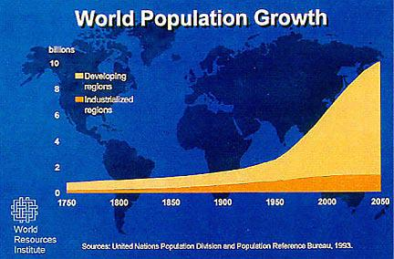
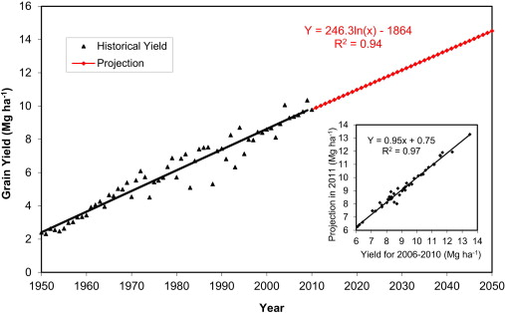
Homework:
150 word response to:
If the world population goes from 6 Billion people to 12 Billion people in the next 30 years and the amount of land use for agriculture does not increase, can we feed everyone?
Why or why not? You can apply some math here. What factors will determine if we can or can’t?

